Slide 1


Health Data Analysis for Future Preparation
Insights from Heart Disease Diagnostic Database. Presented by Shivam Singh Raghuvanshi on 17-May-2024.
by Shivam Singh Raghuvanshi

Slide 2

Problem Statement
The objective of this analysis is to understand health and medical data, with a focus on heart disease rates by gender and age. This is crucial for devising preventive measures and allocating resources effectively in preparation for future health crises.
1
Analyze health and medical data to prepare for future health crises
Focus on heart disease rates by gender and age
Understand health trends to inform preventive measures and resource allocation

Slide 3

Dataset Overview
1
Source: Heart disease diagnostic database
Link: Dataset Link
Attributes:
Heart disease rates
Gender
Age

Slide 4




ETL Process
Extract
Load dataset from provided link, ensure data integrity
Transform
Clean and preprocess data, aggregate by gender and age
Load
Store transformed data for analysis and visualization

Slide 5



Tools and Techniques
Python
Data Libraries
Visualization
Primary programming language for analysis
Pandas, Matplotlib, Seaborn, NumPy
Tableau and Power BI for insights

Slide 6
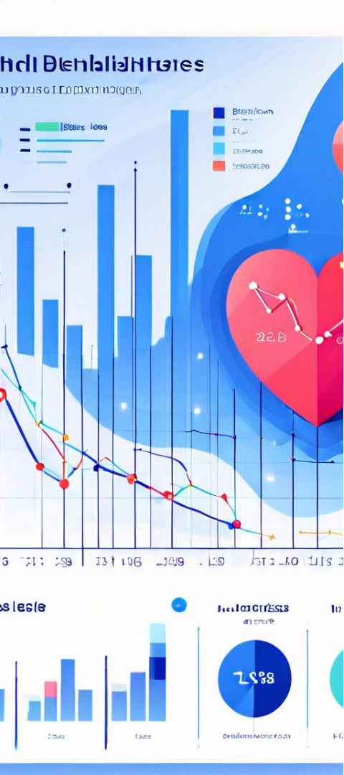
Key Metrics
Heart Disease Rates
Heart Disease by Gender
Analyze overall prevalence of heart disease
Compare rates between males and females
Heart Disease by Age
Examine prevalence across different age groups

Slide 7
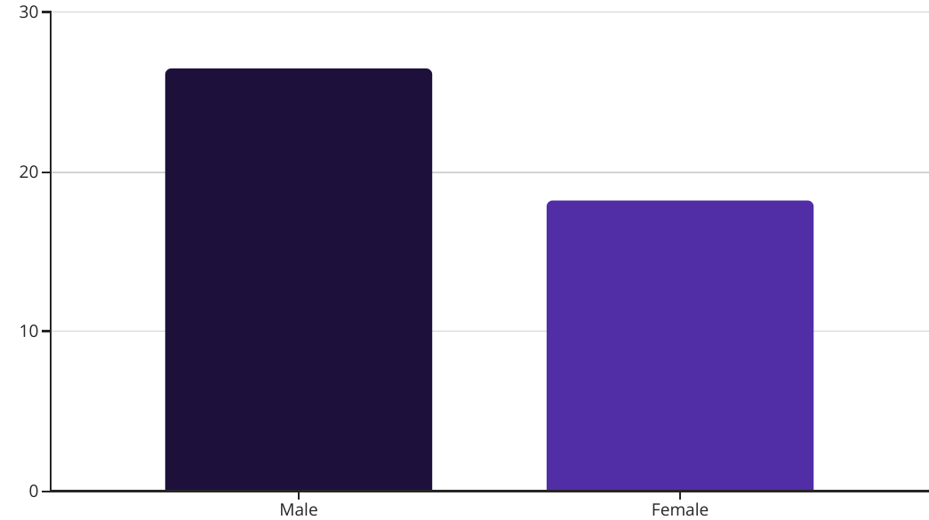
Heart Disease by Gender
The bar chart highlights a significant difference in heart disease prevalence between men and women. Men exhibit a notably higher rate of heart disease compared to women.
These findings suggest potential gender-specific factors, such as biological, behavioral, or environmental influences, that may contribute to the divergent heart disease patterns. Further investigation is needed to understand the underlying causes and develop targeted healthcare strategies to address this disparity.

Slide 8
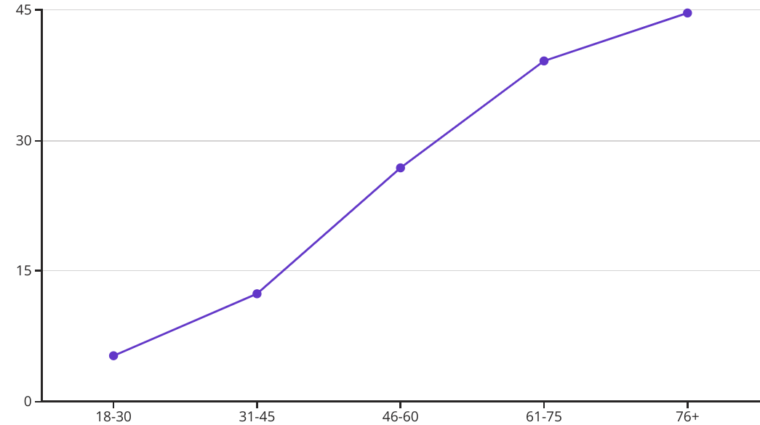
Heart Disease by Age
The line chart reveals a clear trend of increasing heart disease rates as age increases. The prevalence is lowest among the 18-30 age group and steadily rises, reaching a peak in the 76+ age group.
These findings suggest that older individuals are at a significantly higher risk of developing heart disease, highlighting the importance of targeted prevention and early intervention strategies for this vulnerable population. Factors such as lifestyle, genetic predisposition, and underlying health conditions may contribute to the age-related differences in heart disease prevalence.

Slide 9

Relationship Analysis
Explored connections between heart disease rates and demographic factors like gender and age. Identified key predictors of heart disease risk through statistical modeling.
Visualized insights using scatterplots, heatmaps, and other analytical tools to uncover patterns and interdependencies in the data.

Slide 10
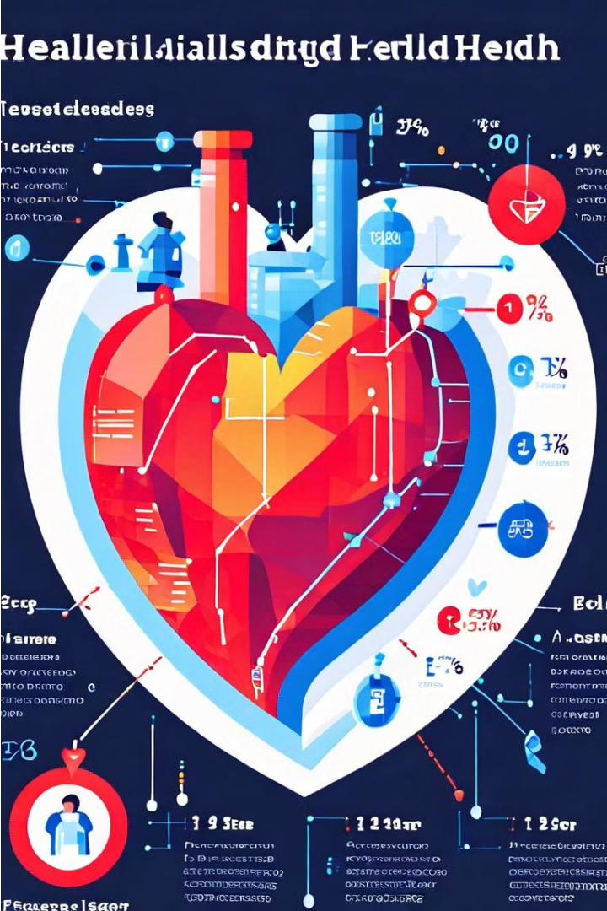
Findings and Insights
Key Observations: The analysis revealed significant disparities in heart disease prevalence between genders and across age groups. Men exhibited notably higher rates of heart disease compared to women, while the risk escalated substantially with increasing age.
Actionable Insights: These findings underscore the need for targeted healthcare policies and preventive strategies that address gender-specific and age-related risk factors. Tailored screening programs, educational campaigns, and lifestyle interventions could help mitigate the burden of heart disease.
Future Work: Further research is warranted to explore the underlying causes of the observed patterns, such as biological, behavioral, and environmental influences. Expanding the data collection to include additional demographic and clinical factors could provide deeper insights and inform more comprehensive prevention and treatment approaches.

Slide 11

Thank You
We appreciate your time and attention throughout this presentation on health data analysis for future preparation.

